Slide 1
15-780 – Graduate Artificial Intelligence:
(Very brief) Unsupervised learning
Aditi Raghunathan
Carnegie Mellon University
Spring 2023

Slide 2




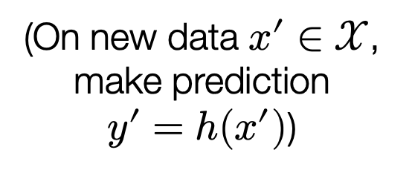
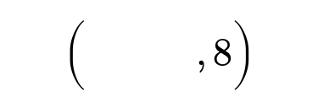

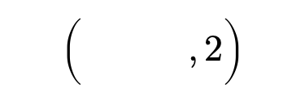
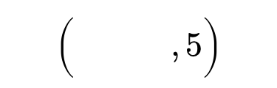

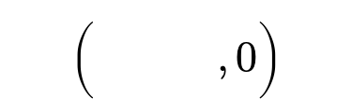
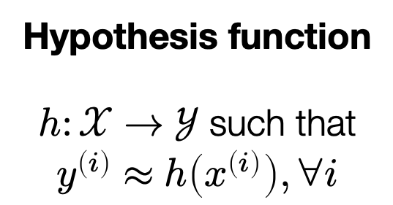
Supervised learning pipeline
Training data
$$\left(\begin{matrix} & \\ & \end{matrix},2\right)$$
$$\left(\begin{matrix} & \\ & \end{matrix},0\right)$$
Hypothesis function
$h:𝒳→𝒴$ such that
$$y^{\left(i\right)}≈h\left(x^{\left(i\right)}\right), ∀i$$
Machine learning algorithm
$$\left(\begin{matrix} & \\ & \end{matrix},5\right)$$
$$\left(\begin{matrix} & \\ & \end{matrix},8\right)$$
(On new data $x^{′}∈𝒳$, make prediction
$y^{′}=h(x^{′})$)
$$y^{\left(i\right)}∈𝒴$$
$$x^{\left(i\right)}∈𝒳$$
Labels are expensive to obtain!

Slide 3
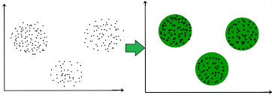
Unsupervised learning
Can we learn from data without explicit reinforcements?
Canonical example: clustering

Slide 4
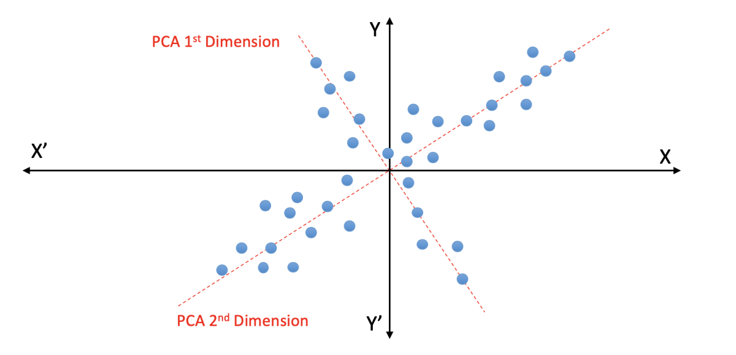
Unsupervised learning
Can we learn from data without explicit reinforcements?
Canonical example: Principal component analysis

Slide 5
Unsupervised learning
Goal is to learn from unlabeled data (much more scalable)
Two general approaches
  Model the generative process to get new samples
  Learn useful representations for various downstream tasks
One can get useful representations from the generative process
One can get useful representations in other ways as well..

Slide 6
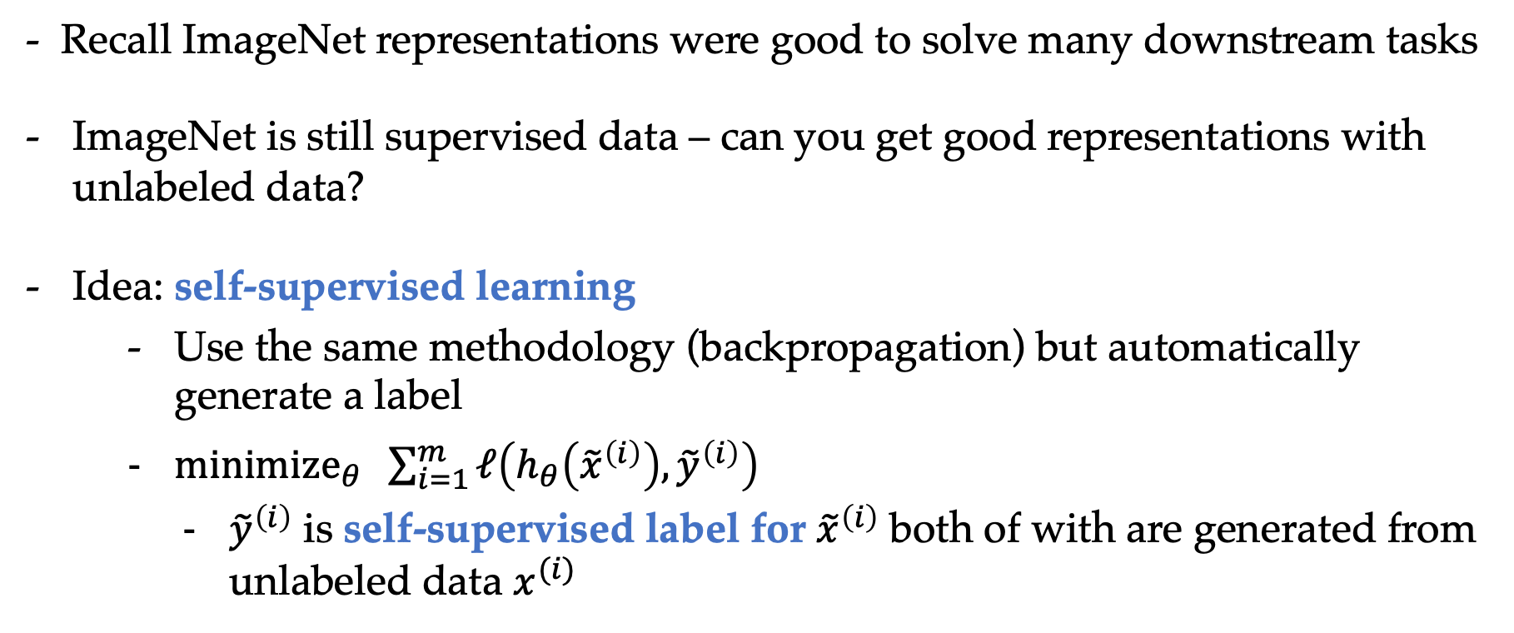
How to get good representations?
- Recall ImageNet representations were good to solve many downstream tasks
ImageNet is still supervised data – can you get good representations with unlabeled data?
Idea: self-supervised learning
  Use the same methodology (backpropagation) but automatically generate a label
  ${minimize}_{θ} \sum_{i=1}^{m}{ℓ\left(h_{θ}\left({\tilde{x}}^{\left(i\right)}\right), {\tilde{y}}^{\left(i\right)}\right)}$
    ${\tilde{y}}^{\left(i\right)}$ is self-supervised label for ${\tilde{x}}^{\left(i\right)}$ both of with are generated from unlabeled data $x^{(i)}$

Slide 7
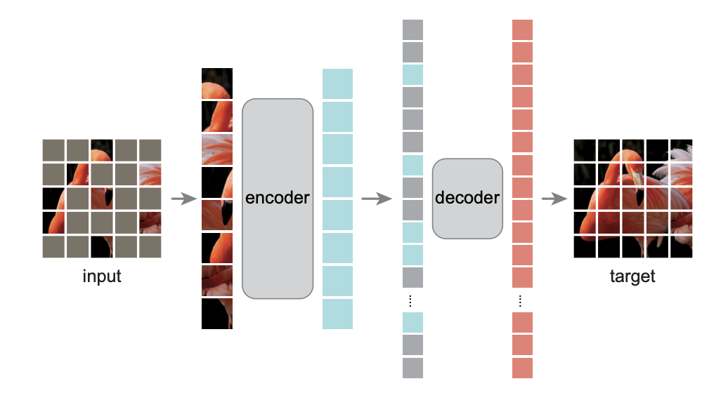
Self-supervised learning: example
Task: predict masked patches
Masked auto-encoders He et al.

Slide 8
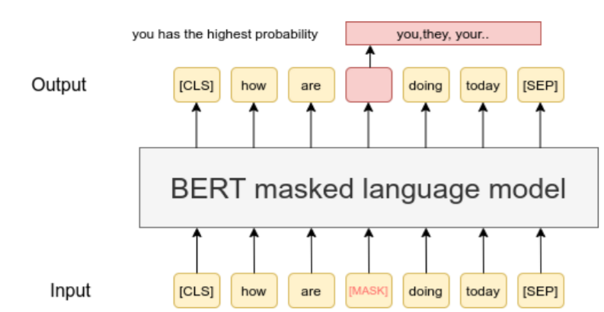
Self-supervised learning: example

Slide 9
Autoregressive language modeling
Can directly model the data, for example probability distribution over sequences of words
Autoregressive: generate the next word based on words predicted so far
Simple idea powers the core of ChatGPT
  Involves other components like learning from human feedback

Slide 10
Power of language modeling
Initial goal was to use unsupervised learning to get good representations
When we have a powerful language model, we can use it to solve the task directly
[Input question] is the “prompt” and the model’s completion would be the corresponding answer

Slide 11
All the ingredients..
Training data: Data on the web
Loss function: Measuring prediction of next word given previous words
Architecture: Using the attention building block
Training algorithm: Backpropagation

